Slide 1


          University of Diyala
          College of Engineering
          Department of Electronics Engineering
Course Number: U103
Course Name: Computer Networks
Lecture (1)
Asst. Lect. Ahmed Mohammed Ahmed

Slide 2
Data Communication: - When we communicate, we are sharing information. This sharing can be local or remote. Between individuals, local communication usually occurs face to face, while remote communication takes place over distance. The term telecommunication, which includes telephony, telegraphy, and television, means communication at a distance (tele is Greek for "far"). The word data refers to information presented in whatever form is agreed upon by the parties creating and using the data. Data communications are the exchange of data between two devices via some form of transmission medium such as a wire cable. For data communications to occur, the communicating devices must be part of a communication system made up of a combination of hardware (physical equipment) and software (programs). The effectiveness of a data communications system depends on four fundamental characteristics: delivery, accuracy, timeliness, and jitter.

Slide 3
Delivery. The system must deliver data to the correct destination. Data must be received by the intended device or user and only by that device or user.
Accuracy. The system must deliver the data accurately. Data that have been altered in transmission and left uncorrected are unusable.
Timeliness. The system must deliver data in a timely manner. Data delivered late are useless. In the case of video and audio, timely delivery means delivering data as they are produced, in the same order that they are produced, and without significant delay. This kind of delivery is called real-time transmission.
Jitter. Jitter refers to the variation in the packet arrival time. It is the uneven delay in the delivery of audio or video packets. For example, let us assume that video packets are sent every 3D ms. If some of the packets arrive with 3D-ms delay and others with 4D-ms delay, an uneven quality in the video is the result.

Slide 4
Components of a data communication system
The five components of data communication system are: - (as shown in fig (1))
Message. The message is the information (data) to be communicated. Popular forms of information include text, numbers, pictures, audio, and video.
Sender. The sender is the device that sends the data message. It can be a computer, workstation, telephone handset, video camera, and so on.
Receiver. The receiver is the device that receives the message. It can be a computer, workstation, telephone handset, television, and so on.
Transmission medium. The transmission medium is the physical path by which a message travels from sender to receiver. Some examples of transmission media include twisted-pair wire, coaxial cable, fiber-optic cable, and radio waves.
Protocol. A protocol is a set of rules that govern data communications. It represents an agreement between the communicating devices. Without a protocol, two devices may be connected but not communicating, just as a person speaking French cannot be understood by a person who speaks only Japanese.

Slide 5
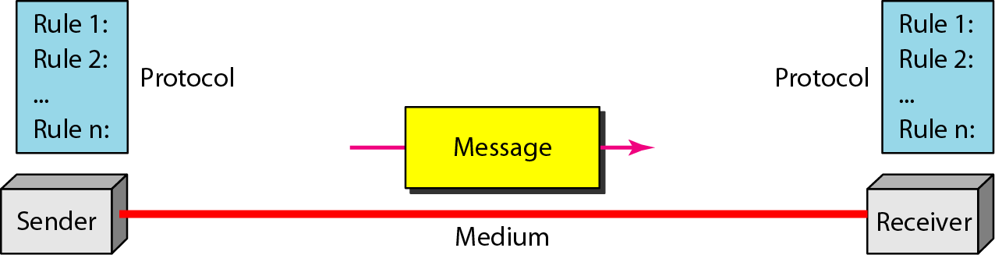

Slide 6
Data Representation
Information today comes in different forms such as text, numbers, images, audio, and video.
Text: - In data communications, text is represented as a bit pattern, a sequence of bits (Os’ or 1s). Different sets of bit patterns have been designed to represent text symbols. Each set is called a code, and the process of representing symbols is called coding. Today, the prevalent coding system is called Unicode, which uses 32 bits to represent a symbol or character used in any language in the world. The American Standard Code for Information Interchange (ASCII) developed some decades ago in the United States, now constitutes the first 127 characters in Unicode and is also referred to as Basic Latin.

Slide 7
Numbers: - Numbers are also represented by bit patterns. However, a code such as ASCII is not used to represent numbers; the number is directly converted to a binary number to simplify mathematical operations.
Images: - Images are also represented by bit patterns. In its simplest form, an image is composed of a matrix of pixels (picture elements), where each pixel is a small dot. The size of the pixel depends on the resolution. For example, an image can be divided into 1000 pixels or 10,000 pixels. In the second case, there is a better representation of the image (better resolution), but more memory is needed to store the image. After an image is divided into pixels, each pixel is assigned a bit pattern. The size and the value of the pattern depend on the image. For an image made of only black and- white dots (e.g., a chessboard), a 1-bit pattern is enough to represent a pixel.

Slide 8
Audio: - Audio refers to the recording or broadcasting of sound or music. Audio is by nature different from text, numbers, or images. It is continuous, not discrete. Even when we use a microphone to change voice or music to an electric signal, we create a continuous signal.
Video: - Video refers to the recording or broadcasting of a picture or movie. Video can either be produced as a continuous entity (e.g., by a TV camera), or it can be a combination of images, each a discrete entity, arranged to convey the idea of motion.

Slide 9
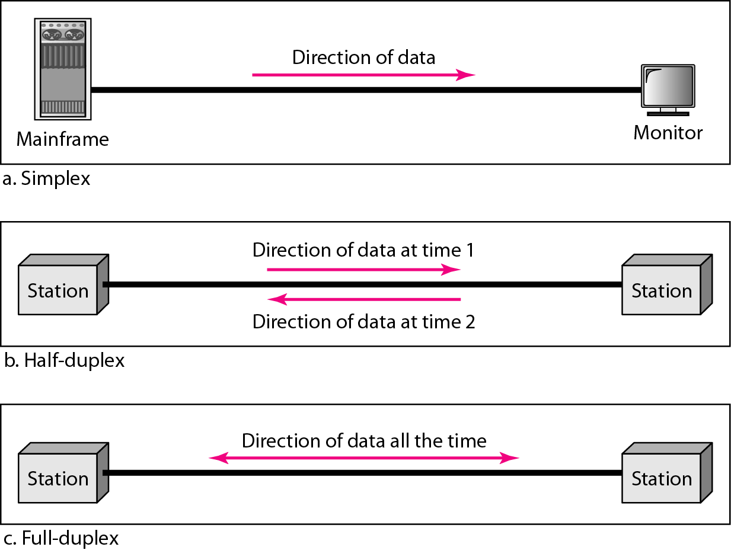
Data Flow
Communication between two devices can be simplex, half-duplex, or full-duplex as shown in Figure 2.

Slide 10
Simplex: - In simplex mode, the communication is unidirectional, as on a one-way street. Only one of the two devices on a link can transmit; the other can only receive (see Figure 1.2a). Keyboards and traditional monitors are examples of simplex devices. The keyboard can only introduce input; the monitor can only accept output. The simplex mode can use the entire capacity of the channel to send data in one direction.

Slide 11
Half-Duplex: - In half-duplex mode, each station can both transmit and receive, but not at the same time. When one device is sending, the other can only receive, and vice versa (see Figure 2b). The half-duplex mode is like a one-lane road with traffic allowed in both directions. When cars are traveling in one direction, cars going the other way must wait. In a half-duplex transmission, the entire capacity of a channel is taken over by whichever of the two devices is transmitting at the time. Walkie-talkies and CB (citizens band) radios are both half-duplex systems. The half-duplex mode is used in cases where there is no need for communication in both directions at the same time; the entire capacity of the channel can be utilized for each direction.

Slide 12
Full-Duplex: - In full-duplex mode (also called duplex), both stations can transmit and receive simultaneously (see Figure 2). The full-duplex mode is like a two-way street with traffic flowing in both directions at the same time. In full-duplex mode, signals going in one direction share the capacity of the link: with signals going in the other direction. This sharing can occur in two ways: Either the link must contain two physically separate transmission paths, one for sending and the other for receiving; or the capacity of the channel is divided between signals traveling in both directions. One common example of full-duplex communication is the telephone network. When two people are communicating by a telephone line, both can talk and listen at the same time.

Slide 13
NETWORKS
A network is a set of devices (often referred to as nodes) connected by communication links. A node can be a computer, printer, or any other device capable of sending and/or receiving data generated by other nodes on the network.
Most networks use distributed processing, in which a task is divided among multiple computers. Instead of one single large machine being responsible for all aspects of process, separate computers (usually a personal computer or workstation) handle a subset.

Slide 14
Network Criteria
A network must be able to meet a certain number of criteria. The most important of these are:-
Performance.
Reliability.
Security.
Performance: - Performance can be measured in many ways, including transit time and response time. Transit time is the amount of time required for a message to travel from one device to another. Response time is the elapsed time between an inquiry and a response. The performance of a network depends on a number of factors, including the number of users, the type of transmission medium, the capabilities of the connected hardware, and the efficiency of the software. Performance is often evaluated by two networking metrics: throughput and delay. We often need more throughputs and less delay. However, these two criteria are often contradictory. If we try to send more data to the network, we may increase throughput but we increase the delay because of traffic congestion in the network.
Reliability: - In addition to accuracy of delivery, network reliability is measured by the frequency of failure, the time it takes a link to recover from a failure, and the network's robustness in a catastrophe.
Security: - Network security issues include protecting data from unauthorized access, protecting data from damage and development, and implementing policies and procedures for recovery from breaches and data losses.

Slide 15
Network Connection
Type of connection: - A network is two or more devices connected through links. A link is a communications pathway that transfers data from one device to another. There are two possible types of connections: point-to-point and multipoint.
Point-to-Point:- (single transmitter and receiver) a point-to-point connection provides a dedicated link between two devices. The entire capacity of the link is reserved for transmission between those two devices. Most point-to-point connections use an actual length of wire or cable to connect the two ends, but other options, such as microwave or satellite links, are also possible (see Figure 3a).
Multipoint A multipoint: - (multiple recipients of single transmission) (also called multi-drop) connection is one in which more than two specific devices share a single link (see Figure 3b). In a multipoint environment, the capacity of the channel is shared, either spatially or temporally. If several devices can use the link simultaneously, it is a spatially shared connection. If users must take turns, it is a timeshared connection.

